Slide 1
Employee Retention Credit
September 30, 2021

Slide 2
Speaker
Christine Ulibarri, CPA, CCICP
Shareholder, Tax, Phoenix
culibarri@beachfleischman.com

Slide 3
Disclaimer
This presentation is based on relevant government guidance available as of September 30, 2021. This presentation includes our best interpretation of the guidance available today.
Consult with your tax advisor.

Slide 4
Employee
Retention
Credit

Slide 5
Employee Retention Credit (ERC)
Authoritative guidance on ERC:
3/27/20 CARES Act
12/27/20 Consolidated Appropriations Act
3/1/21 IRS Notice 2021-20
3/11/21 American Rescue Plan Act of 2021
4/2/21 IRS Notice 2021-23
8/4/21 IRS Notice 2021-49
8/10/21 Rev Proc 2021-33
X/XX/?? Infrastructure Bill (HR 3684)

Slide 6
Employee Retention Credit (ERC)
The Consolidated Appropriations Act (CAA), which was passed in late 2020 did two things:
Removed the prohibition against companies who receive a PPP loan from taking the ERC
Extended the ERC through June 30, 2021 with some modifications to the rules for 2021

Slide 7
Employee Retention Credit (ERC)
The American Rescue Plan Act of 2021 (ARPA), which was passed in March 2021 did few more things:
Added a new category of eligible businesses: Recovery Start Up Businesses (RSB)
Added revised rules for a business deemed a Severely Financially Distressed Employer
Extended the ERC through December 31, 2021
Extended the statute of limitations for IRS assessment from 3 to 5 years

Slide 8
Employee Retention Credit (ERC)
What is a Recovery Startup Business?
Operation of trade or business began after February 15, 2020 (could have been legally organized beforehand)
Average annual gross receipts of less than $1,000,000 for the three taxable years ending prior to the quarter claiming the credit
Does not otherwise qualify (partial shutdown or gross receipts tests)
Can claim ERC for Q3 and Q4 of 2021
Maximum credit for each quarter is $50,000

Slide 9
Employee Retention Credit (ERC)
What is a Severely Financially Distressed Employer (SFDE)?
A business with a decline in 2021 Q3 or Q4 gross receipts of more than 90% compared to the same calendar quarter of 2019 even if the business is a large employer (more than 500 FTE’s)
An SFDE may treat all wages up to the $10,000 limitation as qualified ERC wages
Whether employees are performing services is not relevant
Effective for wages paid between July 1, 2021 and December 31, 2021

Slide 10
ERC – IRS Notice 2021-49
The credit reduces the wage/health insurance deduction on the tax return for the tax year of the credit.
If you file retroactive claims for 2020, amended 2020 company tax returns (and related individual returns for an s-corp or partnership) will be required.
There will be tax due, and potentially interest and penalties associated with the amended returns.

Slide 11
ERC – IRS Notice 2021-49
Tips are eligible wages for purposes of ERC
Clarified the related party restrictions
Provided guidance on the gross receipts rule for: - acquisitions - new businesses formed in 2020

Slide 12
ERC – IRS Rev Proc 2021-33
Excluded the following amounts from Gross Receipts when determining eligibility:
PPP Loan forgiveness amount
Shuttered Venue Operators Grants
Restaurant Revitalization Grants

Slide 13
ERC – BOLO
Be on the lookout for what happens with the current Infrastructure Bill.
Current version would end the ERC program on September 30, 2021. The only exception would be for wages paid by an eligible Recovery Startup Business.
Congressional action could come at any time
Or not….

Slide 14
Employee Retention Credit (ERC)
The ERC is computed using eligible wages and allocable health care costs:
Eligible wages are generally gross FICA wages paid during the relevant period
Allocable health care costs are costs for insurance that are related to the relevant period (could be paid earlier or later)

Slide 15
ERC Eligibility
The credit is available for: - March 12, 2020 – December 31, 2020 and - January 1, 2021 – December 31, 2021
The eligibility and credit computations are slightly different for 2020 and 2021
We will address each year individually

Slide 16
2020
The following slides are related to the ERC for 2020, and 2020 only.
Before we start talking about 2021, you will see another blue slide like this.
Do not confuse the rules for each year.

Slide 17
ERC 2020 - Eligibility
Two different ways to be eligible for the 2020 credit:
Business had operations that were fully or partially suspended during any calendar quarter in 2020 due to government COVID-related orders. The credit only applies to wages paid during the portion of the quarter that the business is suspended, not the entire quarter, OR
Business experienced a significant decline in gross receipts during any quarter in 2020. An employer is considered to have a significant decline in gross receipts for the period beginning with the first quarter in 2020 for which its gross receipts are less than 50 percent of gross receipts from the same quarter in 2019 and ending with the earlier of January 1, 2021 or the first quarter after the quarter for which gross receipts are greater than 80 percent of gross receipts for the same quarter in 2019.

Slide 18
ERC 2020 - Eligibility
For the first bullet, the company should document the specific government orders that caused them to be fully or partially shut down
Partial shutdown – nonessential operations must represent more than 10% of revenue in the same period in 2019
Shut down could also be due to lack of materials from suppliers who were shut down
Only wages and allocable health costs during the shut down period are eligible for the ERC

Slide 19
ERC 2020 - Eligibility
Partial Shutdown Example #1:
A restaurant that is primarily a dine-in operation is limited by an Executive Order from the Arizona Governor to only take out orders on March 20, 2020. On May 11, 2020, a subsequent Executive Order allows dine-in operations to resume at 50% capacity through December 31, 2020.
This restaurant is deemed to have essential (take out) and nonessential (dine-in) operations. The nonessential operations that are restricted by government order (dine-in) represented more than 10% of revenues in 2019. This restaurant has experienced an eligible partial shutdown for the period March 20, 2020 through December 31, 2020.

Slide 20
ERC 2020 - Eligibility
Partial Shutdown Example #2:
A traditional dentist is limited by an Executive Order from the Arizona Governor to only perform emergency services beginning March 21, 2020. A subsequent Executive Order allows all dental services to resume on May 1, 2020 as long as proper PPE, cleaning and social distancing measures are put into place. During the 1st and 2nd quarter of 2019, non-emergency services (cleanings and preventive care) represented over 40% of the dentist’s revenues.
This dentist is deemed to have essential (emergency) and nonessential (routine) operations. The nonessential operations that are restricted by government order (routine) represented more than 10% of revenues in 2019. This dentist has experienced an eligible partial shutdown for the period March 21, 2020 through April 30, 2020.

Slide 21
ERC 2020 - Eligibility
Two different ways to be eligible for the 2020 credit:
Business had operations that were fully or partially suspended during any calendar quarter in 2020 due to government COVID-related orders. The credit only applies to wages paid during the portion of the quarter that the business is suspended, not the entire quarter, OR
Business experienced a significant decline in gross receipts during any quarter in 2020. An employer is considered to have a significant decline in gross receipts for the period beginning with the first quarter in 2020 for which its gross receipts are less than 50 percent of gross receipts from the same quarter in 2019 and ending with the earlier of January 1, 2021 or the first quarter after the quarter for which gross receipts are greater than 80 percent of gross receipts for the same quarter in 2019.

Slide 22
ERC 2020 - Eligibility
For the gross receipts test, the company will have to look at 2020 and 2019 gross receipts
Use the accounting method that the company uses for internal accounting or their income tax method of accounting

Slide 23
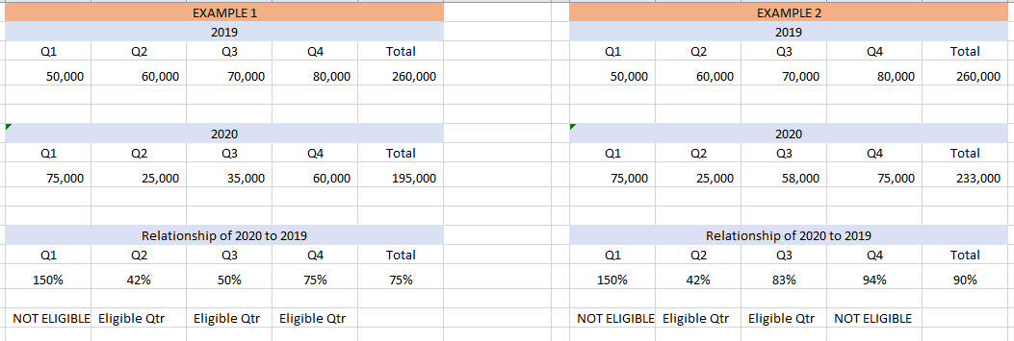
ERC 2020 - Eligibility

Slide 24
ERC 2020 – Compute the Credit
Costs eligible for the credit are dependent on how many full-time employees (EEs) you had in 2019.
Only include EEs who average more than 30 hours/week or 130 hours/month
Formula:
Number of full-time EEs in each calendar month in 2019
12

Slide 25
ERC 2020 – Compute the Credit
How do you determine whether an employee is a full-time employee in a given month? 130 hours/month test
In Excel, the formula looks like this: =IF(E4>130,1,0)

Slide 26
ERC 2020 – Compute the Credit
How do you determine whether an employee is a full-time employee in a given month? 30 hours/week test
In Excel, the formula looks like this: =IF(F4>30,1,0)

Slide 27
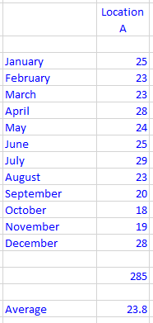
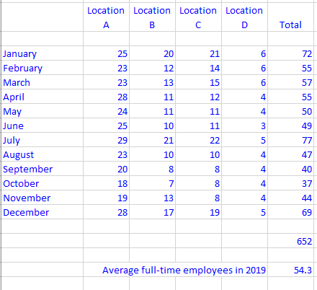
ERC 2020 – Compute the Credit
Compile the number of full-time employees by month and compute the average. If you have multiple locations/businesses they must be aggregated:

Slide 28
ERC 2020 – Compute the Credit
Employers with 100 or fewer full-time EEs in 2019 can use all wages (including health care costs) paid: during the affected period/quarter and after March 12, 2020, minus any FFCRA wages.
Employers with more than 100 employees can only take the credit on wages and health care costs paid to/for employees who were not working (literally paid while staying home and not providing services).

Slide 29
ERC 2020 – Compute the Credit
The credit is the first 50% of the first $10,000 in wages and allocable health care costs paid during the affected period/quarter to each eligible employee
Maximum eligible wages between March 12 – December 31, 2020 is $10,000.
Maximum credit for 2020 is $5,000 per employee

Slide 30
ERC 2020 – Compute the Credit
Important restriction #1:
Wages do not include wages paid under the family and/or sick leave provisions of FFCRA, the Families First Coronavirus Response Act. In addition, wages claimed for employees under the Work Opportunity Credit do not qualify as wages that may increase this credit.

Slide 31
ERC 2020 – Compute the Credit
Important restriction #2:
Wages paid to relatives or family members do not qualify. With entities, one applies these relationship rules depending on a particular level of ownership (>50%).
See question #59: https://www.irs.gov/newsroom/covid-19-related-employee-retention-credits-determining-qualified-wages-faqs

Slide 32
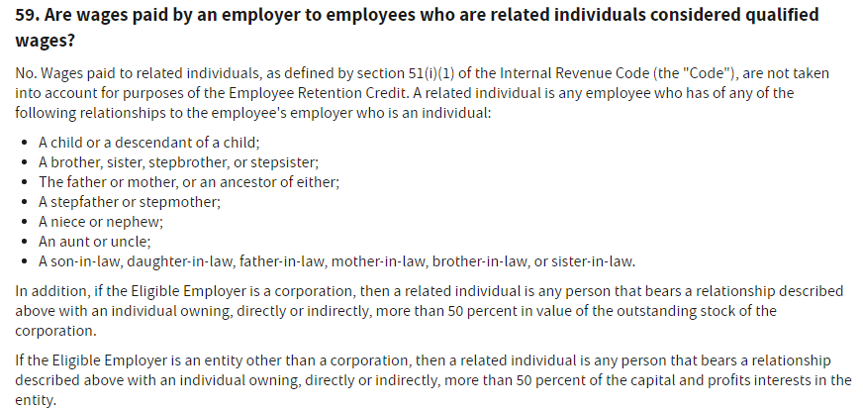
ERC 2020 – Compute the Credit

Slide 33
ERC 2020 – Compute the Credit
Important restriction #3:
Any wages used in the computation of the ERC are not eligible covered costs on the application for forgiveness of a PPP loan.
You can see how retroactively claiming the credit for 2020 gets interesting when you have already received forgiveness. IRS Notice 2021-20 provides guidance.

Slide 34
ERC 2020 – Compute the Credit
Important restriction #4:
There are aggregation rules that can affect parent-subsidiary or brother-sister groups, or a combined group of corporations. These complex rules can also reach partnerships, trusts and estates. Aggregation can affect qualification in such areas as to whether there is a full or partial shutdown, whether a company has < or > 100 employees, as well as measuring the decline in gross receipts.

Slide 35
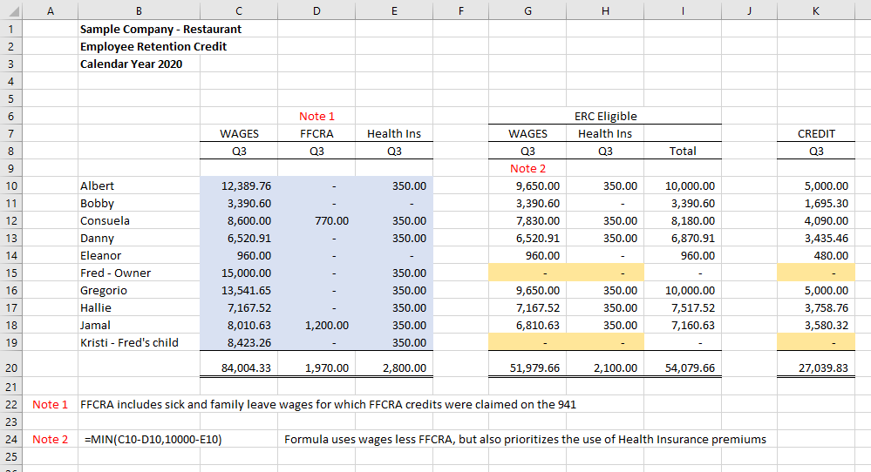

Slide 36
ERC 2020 – Claim the Credit
Claim the credit on Form 941-X
Complete a Form 941-X for each quarter: https://www.irs.gov/pub/irs-pdf/f941x.pdf
Must complete the 941 worksheet to determine the proper amounts to report on the 941-X. It can be found on pages 22-23 of the Instructions: https://www.irs.gov/pub/irs-pdf/i941x.pdf

Slide 37
ERC 2020 – Claim the Credit
The worksheet computes a “refundable portion” and “nonrefundable portion” of the ERC
When you are filing a 941-X, for a quarter where all taxes have been previously paid, the entire ERC will be refunded to you, even though the worksheet requires the computation of both a refundable and nonrefundable portion
The distinction is for the government: which bucket of money your refund comes from.

Slide 38
ERC 2020 – Claim the Credit
The nonrefundable portion only comes into play if you are claiming the ERC currently (on an original 941) in 2021, and have reduced cash payroll tax deposits in anticipation of ERC credits.

Slide 39
ERC 2020
For more details on the ERC 2020, there is an article on our website:
https://beachfleischman.com/tax-bites/2020/04/employee-retention-credit/
The IRS also has extensive FAQs on the ERC:
https://www.irs.gov/newsroom/faqs-employee-retention-credit-under-the-cares-act

Slide 40
SWITCHING GEARS TO 2021
Please note that the slides from this point forward are related to the ERC for 2021.
Do not confuse the rules for each year.

Slide 41
ERC 2021 - Eligibility
Three different ways to be eligible for the 2021 credit:
Business had operations that were fully or partially suspended in 2021 due to government COVID-related orders. The credit only applies to wages paid during the portion of the quarter that the business is suspended, not the entire quarter, OR
Business experienced a significant decline in gross receipts in 2021. An employer is considered to have a significant decline in gross receipts only for the quarters for which its gross receipts are less than 80 percent of gross receipts from the same quarter in 2019, OR
A Recovery start-up business (RSB) or Severely Financially Distressed Employer (SFDE)

Slide 42
ERC 2021 - Eligibility
For the first bullet, the company should document the specific government orders that caused them to be fully or partially shut down
Partial shutdown – nonessential operations are typically more than 10% of revenue
Only wages and allocable health costs during the shut down period are eligible for the ERC

Slide 43
ERC 2021 - Eligibility
For the second bullet, the company will have to look at 2021, 2020 and 2019 gross receipts
Use the accounting method that the company uses for internal accounting or their income tax method of accounting
There is a lookback rule, that says if you don’t meet the test for a quarter you can look at the immediately preceding quarter

Slide 44
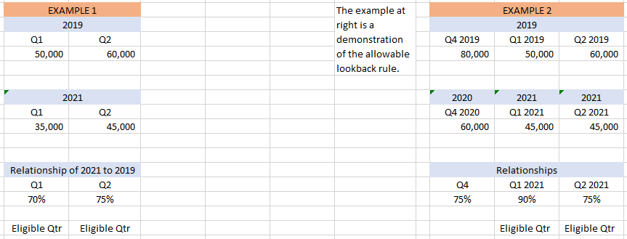
ERC 2021 - Eligibility

Slide 45
ERC 2021 - Eligibility
For the third bullet bullet, see slides at the beginning of this presentation that outlines the definition and rules for a Recovery Startup Business or a Severely Financially Distressed Employer.

Slide 46
ERC 2021 – Compute the Credit
Costs eligible for the credit are dependent on how many full-time employees (EEs) you had in 2019.
Only include EEs who average more than 30 hours/week or 130 hours/month
Formula:
Number of full-time EEs in each calendar month in 2019
12
Same formula, same answer as the 2020 slide.

Slide 47
ERC 2021 – Compute the Credit
How do you determine whether an employee is a full-time employee in a given month? 130 hours/month test
In Excel, the formula looks like this: =IF(E4>130,1,0)

Slide 48
ERC 2021 – Compute the Credit
How do you determine whether an employee is a full-time employee in a given month? 30 hours/week test
In Excel, the formula looks like this: =IF(F4>30,1,0)

Slide 49
ERC 2021 – Compute the Credit
Compile the number of full-time employees by month and compute the average. If you have multiple locations/businesses they must be aggregated:

Slide 50
ERC 2021 – Compute the Credit
Employers with 500 or fewer full-time EEs in 2019 can use all wages (including health care costs) paid: during the affected period/quarter, minus any FFCRA wages.
Employers with more than 500 employees can only take the credit on wages and health care costs paid to/for employees who were not working (literally paid while staying home and not providing services).

Slide 51
ERC 2021 – Compute the Credit
The credit is the first 70% of the first $10,000 in wages and allocable health care costs paid during the affected period/quarter to each eligible employee
Credit is computed independently for all quarters of 2021
Maximum eligible wages in 2021 is $10,000 per quarter
Maximum credit for 2021 is $28,000 per employee

Slide 52
ERC 2021 – Compute the Credit
Important restriction #1:
Wages do not include wages paid under the family and/or sick leave provisions of FFCRA, the Families First Coronavirus Response Act. In addition, wages claimed for employees under the Work Opportunity Credit do not qualify as wages that may increase this credit.

Slide 53
ERC 2021 – Compute the Credit
Important restriction #2:
Wages paid to relatives or family members do not qualify. With entities, one applies these relationship rules depending on a particular level of ownership (>50%).
See question #59: https://www.irs.gov/newsroom/covid-19-related-employee-retention-credits-determining-qualified-wages-faqs

Slide 54
ERC 2021 – Compute the Credit
Important restriction #3:
Any wages used in the computation of the ERC are not eligible covered costs on the application for forgiveness of a PPP loan.
For entities who have received a PPP2 loan, hold off on applying for forgiveness to adequately plan and allocate wages between FFCRA, ERC and PPP.

Slide 55
ERC 2020 – Compute the Credit
Important restriction #4:
There are aggregation rules that can affect parent-subsidiary or brother-sister groups, or a combined group of corporations. These complex rules can also reach partnerships, trusts and estates. Aggregation can affect qualification in such areas as to whether there is a full or partial shutdown, whether a company has < or > 500 employees, as well as measuring the decline in gross receipts.

Slide 56
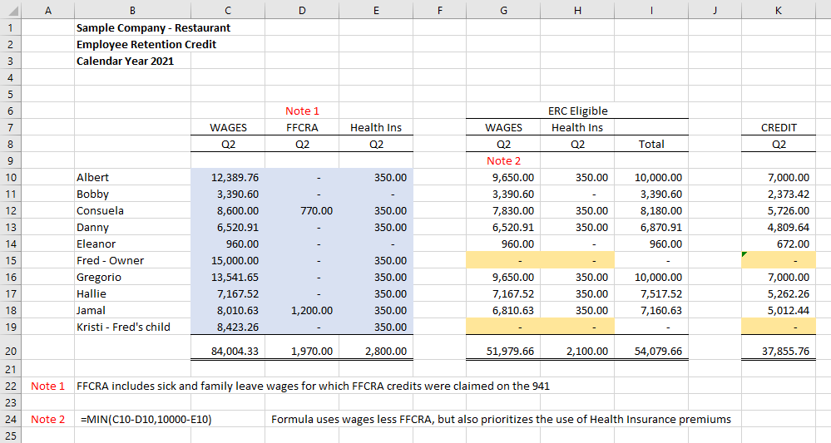

Slide 57
ERC 2021 – Claim the Credit
Claim the credit on an original timely filed Form 941, or on an amended return, Form 941X

Slide 58
ERC 2021 – Claim the Credit
The worksheet computes a “refundable portion” and “nonrefundable portion” of the ERC
Regardless of whether you are filing an original 941 or 941-X, for a quarter where all taxes have been paid, the entire ERC will be refunded to you, even though the worksheet requires the computation of both a refundable and nonrefundable portion.

Slide 59
SWITCHING GEARS

Slide 60
When Will I Get the Money?
If you claim the ERC on an original 941, timely filed, the refund will be processed and sent to you within 30-60 days.
If you claim the ERC on an amended 941, there is no known timeline for when the form will be processed and the refund sent to you.

Slide 61
When Will I Get the Money?
Amended 941s can only be filed on paper.
Due to the lingering effects of COVID shutdowns and social distancing, the IRS is significantly behind on processing paper documents.
They post their status on the “IRS Mission Critical” webpage.

Slide 62
When Will I Get the Money?
https://www.irs.gov/newsroom/irs-operations-during-covid-19-mission-critical-functions-continue
Click on “Filed a Tax Return”
Scroll down to “Status of Processing Form 941”

Slide 63
When Will I Get the Money?
Includes ERC

Slide 64
When Will I Get the Money?
We are not aware of any client who has received a refund from a 941X mailed in 2021 – earliest was mailed in January 2021
We are recommending all 941X be sent via certified mail, return receipt requested, to document your submission.
Be patient. Record a receivable for the tax year that the credit relates to, so that your tax return will be prepared correctly.

Slide 65
Thank You for Attending!

