Slide 1
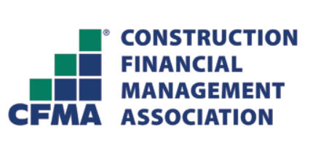
Pledge to STAND Up For Suicide Prevention in the Construction Industry
Notes:
THESE ARE JUST SOME OF THE STATS THE CALCULATOR WILL GENERATE . . .

Slide 2
What is the issue?
More construction workers die by suicide than by all fatal occupational injuries combined
Construction has THE highest rate of suicide
Suicides in the construction industry are 3.5x the national average
Notes:
(Insert personal story here if you’d like)

Slide 3
What can I do about this issue?
Take the Construction Industry Alliance for Suicide Prevention’s (CIASP’s) pledge to STAND up for suicide prevention
Notes:
Help create a zero-suicide industry by taking the Construction Industry Alliance for Suicide Prevention (CIASP) STAND Pledge. This can feel like a big undertaking, but taking the CIASP pledge is a small yet impactful way to support this industry-wide effort.
Contractors, unions, industry associations, industry service providers and project owners must work together. Pledge to STAND up for suicide prevention. Promote the principles outlined in the pledge. Connect your people with the resources so they know how to safely ask the right questions and get the right help.
I will be passing around a QR code that will direct you to the pledge
I have placed information on various tables with the QR code that will direct you to the pledge

Slide 4
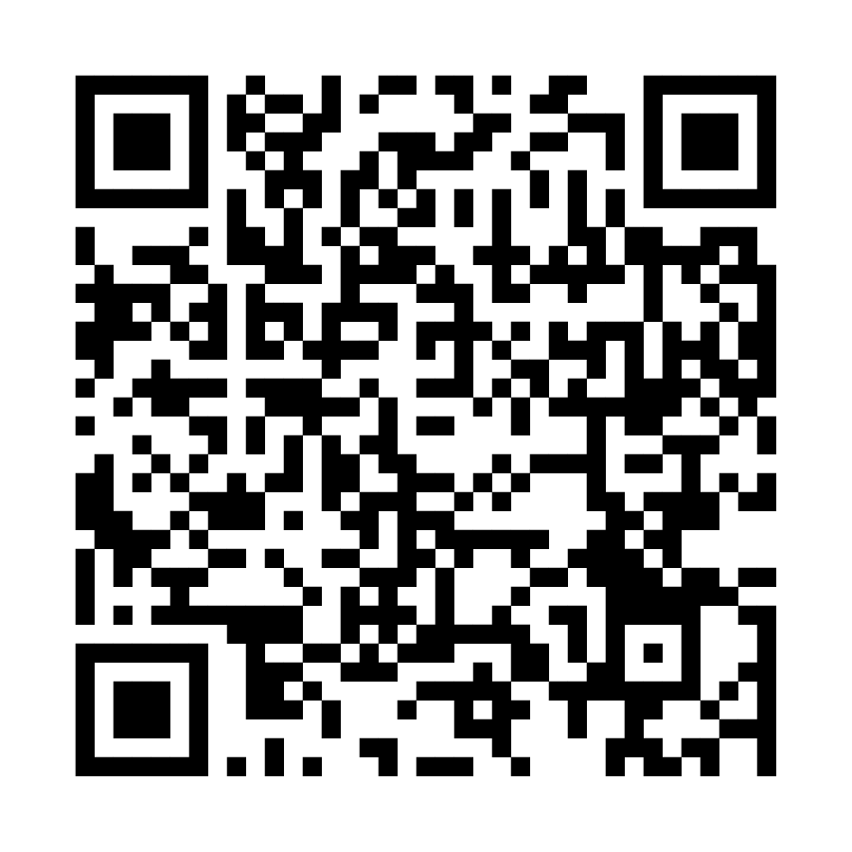
TAKE THE CIASP STAND PLEDGE
Safe: We pledge to create a culture in which team members feel safe to ask for help if they are having suicidal thoughts or if they are concerned that their fellow co-workers are at risk of suicide.
Training: We pledge to make suicide prevention training available to all team members so that they can recognize the warning signs and be equipped to help those at risk.
Awareness: We pledge to raise awareness by sharing the message of suicide prevention through such organizational activities as trainings, safety meetings, toolbox talks, team meetings, newsletters, and social media posts.
Normalize: We pledge to normalize the topic of suicide prevention as a health and safety priority by talking about suicide, suicide prevention, and mental health.
Decrease: We pledge to help decrease the risk of suicide in construction by ensuring that all team members have access to an awareness of our EAP/MAP, behavioral health benefits, screening tools, community crisis support, the Suicide Prevention Lifeline, and Crisis Text Line.
Notes:
When you take the STAND Up for Suicide Prevention, you support the principles set forth by the Construction Industry Alliance for Suicide Prevention.

Slide 5
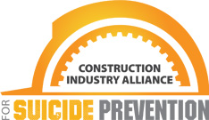
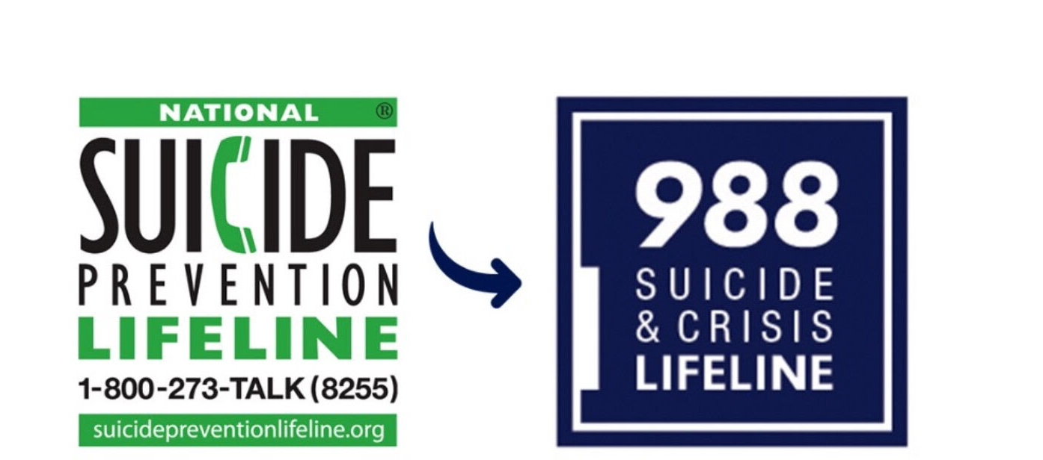
www.preventconstructionsuicide.com
If you or someone you know needs help, call or text the Suicide & Crisis Lifeline
Notes:
Takeaway/Next Steps: Visit www.preventconstructionsuicide.com for training, information, and resources on normalizing the conversation.
If you or someone you know is at risk, text or call the 988 Suicide & Crisis Lifeline at 988 or call 1-800-273-8255.

